Slide 1
module 5
Electronic mail security
mkc
mkc

Slide 2
Outline
Pretty good privacy
S/MIME
Recommended web sites
mkc

Slide 3
Pretty Good Privacy
Philip R. Zimmerman is the creator of PGP.
PGP provides a confidentiality and authentication service that can be used for electronic mail and file storage applications.
mkc

Slide 4
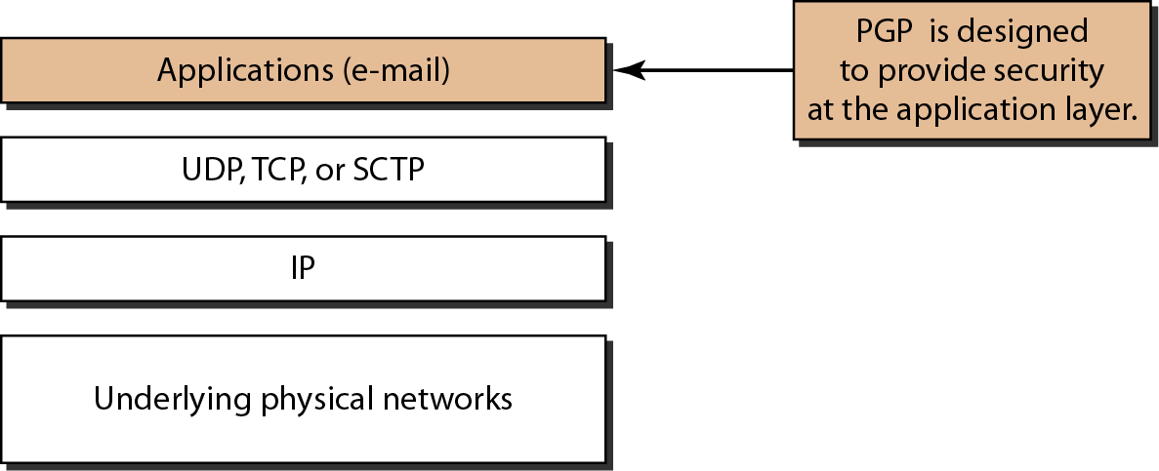
Figure 32.19 Position of PGP in the TCP/IP protocol suite
32.<number>

Slide 5
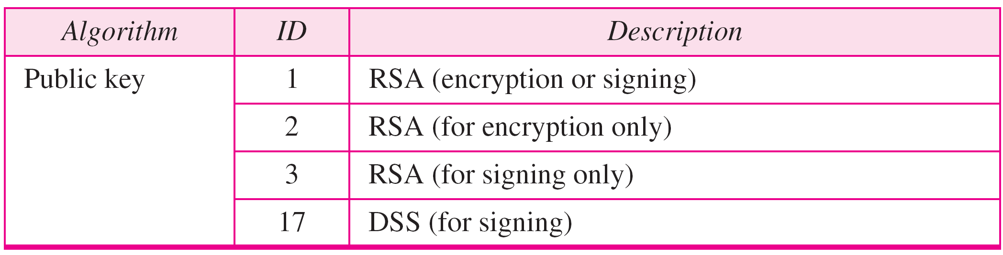
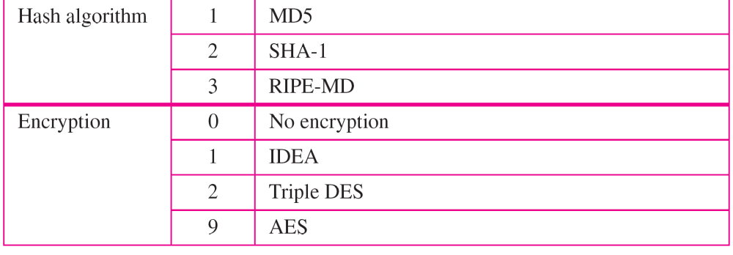
Table 32.4 PGP Algorithms
32.<number>

Slide 6
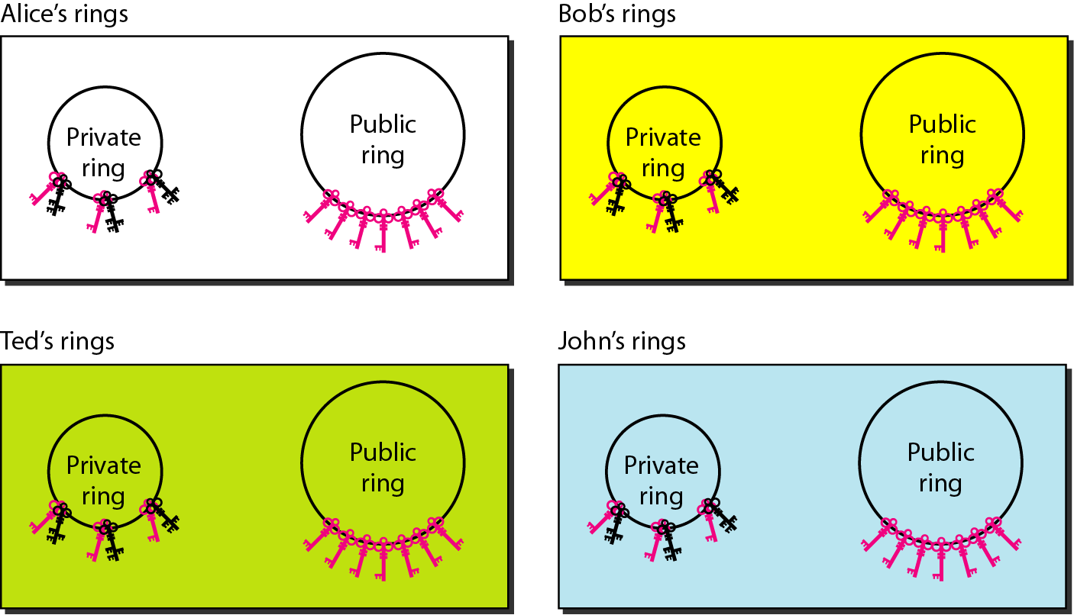
Figure 32.21 Rings
32.<number>

Slide 7

Note
In PGP, there can be multiple paths from fully or partially trusted authorities to any subject.
32.<number>

Slide 8
Why Is PGP Popular?
It is availiable free on a variety of platforms.
Based on well known algorithms.
Wide range of applicability
Not developed or controlled by governmental or standards organizations
mkc

Slide 9
Operational Description
Consist of five services:
  Authentication
  Confidentiality
  Compression
  E-mail compatibility
  Segmentation
mkc

Slide 10
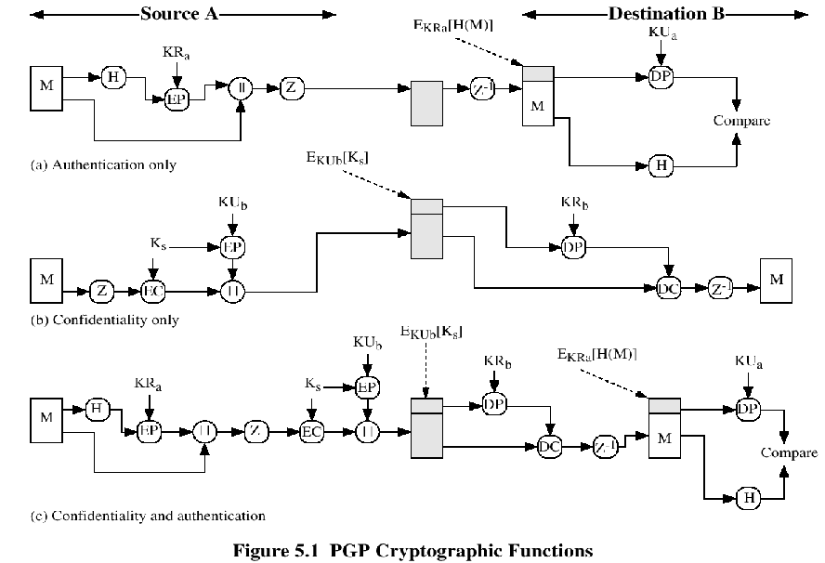
mkc

Slide 11
Compression
PGP compresses the message after applying the signature but before encryption
The placement of the compression algorithm is critical.
The compression algorithm used is ZIP (described in appendix 5A)
mkc

Slide 12
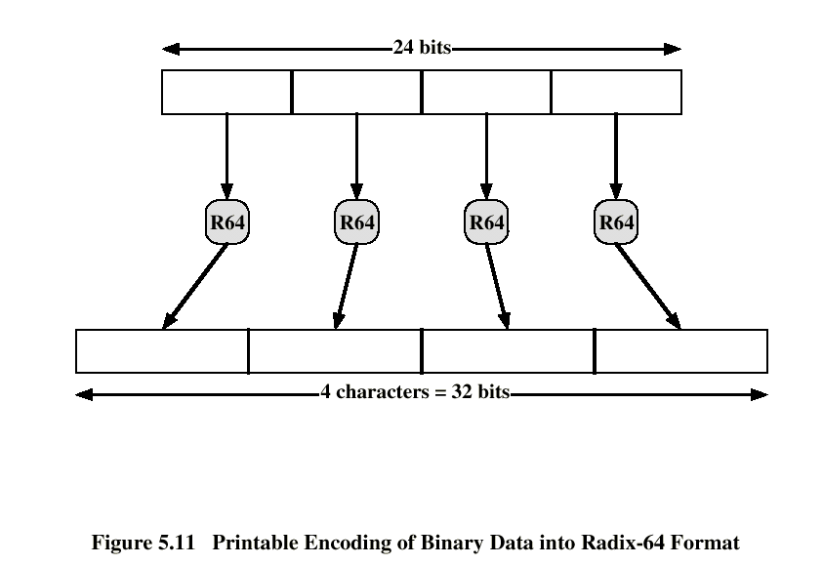
E-mail Compatibility
The scheme used is radix-64 conversion (see appendix 5B).
The use of radix-64 expands the message by 33%.
mkc

Slide 13
Segmentation and Reassembly
Often restricted to a maximum message length of 50,000 octets.
Longer messages must be broken up into segments.
PGP automatically subdivides a message that is to large.
The receiver strip of all e-mail headers and reassemble the block.
mkc

Slide 14
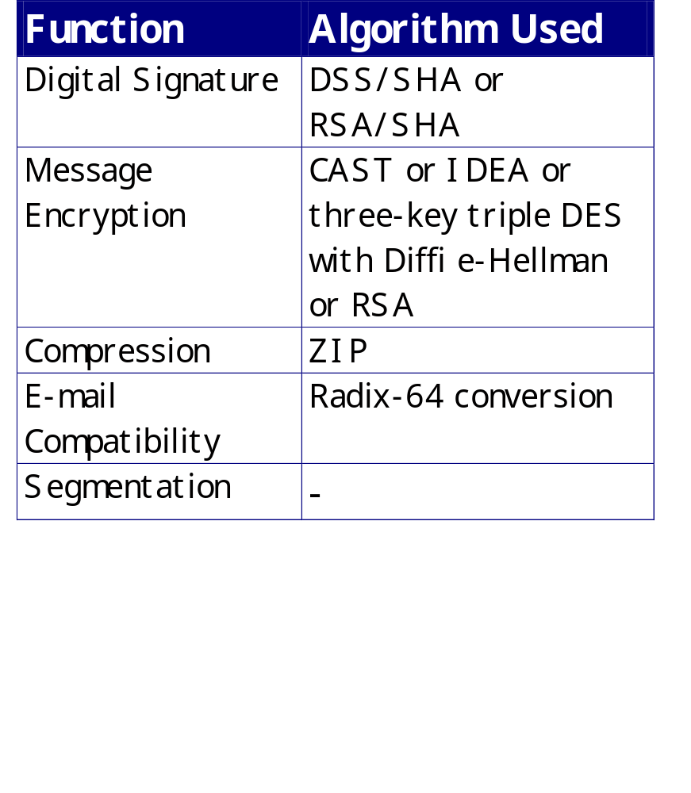
Sumary of PGP Services
mkc

Slide 15
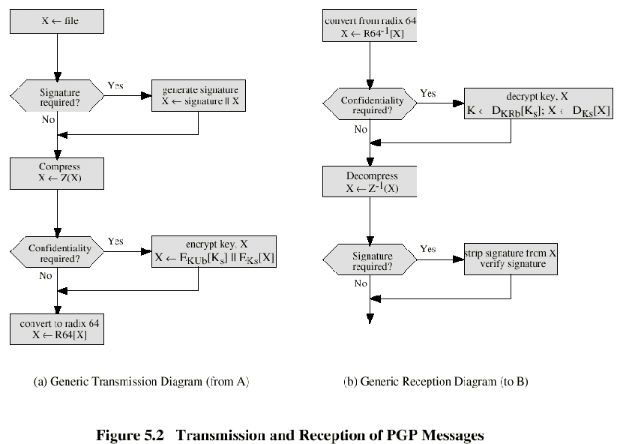
mkc

Slide 16
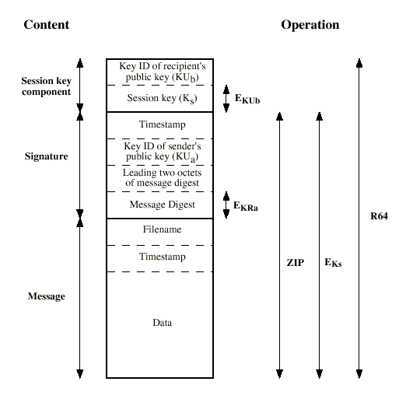
Format of PGP Message
mkc

Slide 17
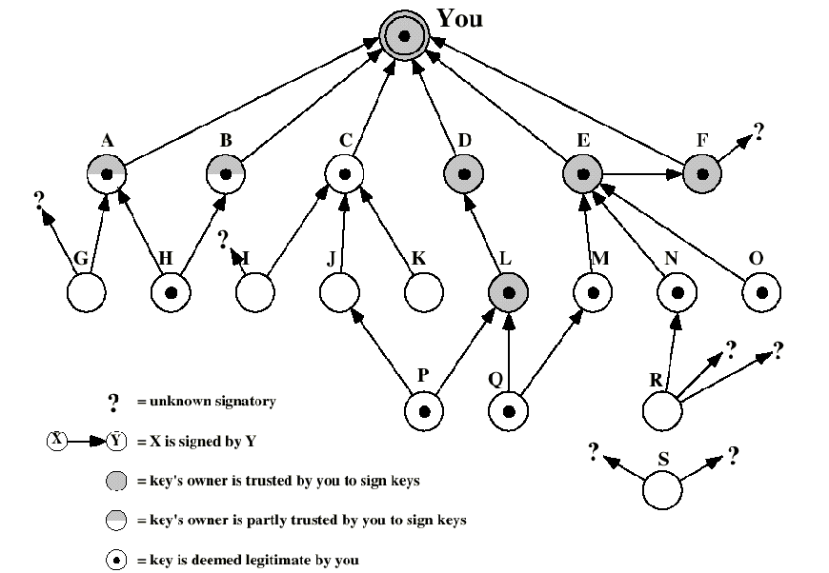
The Use of Trust
mkc

Slide 18
Revoking Public Keys
The owner issue a key revocation certificate.
Normal signature certificate with a revote indicator.
Corresponding private key is used to sign the certificate.
mkc

Slide 19
S/MIME
Secure/Multipurpose Internet Mail Extension
S/MIME will probably emerge as the industry standard.
PGP for personal e-mail security
mkc

Slide 20
Simple Mail Transfer Protocol (SMTP, RFC 822)
SMTP Limitations - Can not transmit, or has a problem with:
  executable files, or other binary files (jpeg image)
  “national language” characters (non-ASCII)
  messages over a certain size
  ASCII to EBCDIC translation problems
  lines longer than a certain length (72 to 254 characters)
mkc

Slide 21
Header fields in MIME
MIME-Version: Must be “1.0” -> RFC 2045, RFC 2046
Content-Type: More types being added by developers (application/word)
Content-Transfer-Encoding: How message has been encoded (radix-64)
Content-ID: Unique identifying character string.
Content Description: Needed when content is not readable text (e.g.,mpeg)
mkc

Slide 22
S/MIME Functions
Enveloped Data: Encrypted content and encrypted session keys for recipients.
Signed Data: Message Digest encrypted with private key of “signer.”
Clear-Signed Data: Signed but not encrypted.
Signed and Enveloped Data: Various orderings for encrypting and signing.
mkc

Slide 23
Algorithms Used
Message Digesting: SHA-1 and MDS
Digital Signatures: DSS
Secret-Key Encryption: Triple-DES, RC2/40 (exportable)
Public-Private Key Encryption: RSA with key sizes of 512 and 1024 bits, and Diffie-Hellman (for session keys).
mkc

Slide 24
User Agent Role
S/MIME uses Public-Key Certificates - X.509 version 3 signed by Certification Authority
Functions:
  Key Generation - Diffie-Hellman, DSS, and RSA key-pairs.
  Registration - Public keys must be registered with X.509 CA.
  Certificate Storage - Local (as in browser application) for different services.
  Signed and Enveloped Data - Various orderings for encrypting and signing.
mkc

Slide 25
User Agent Role
Example: Verisign (www.verisign.com)
  Class-1: Buyer’s email address confirmed by emailing vital info.
  Class-2: Postal address is confirmed as well, and data checked against directories.
  Class-3: Buyer must appear in person, or send notarized documents.
mkc

Slide 26
Recommended Web Sites
PGP home page: www.pgp.com
MIT distribution site for PGP
S/MIME Charter
S/MIME Central: RSA Inc.’s Web Site
mkc

